Slide 1
8-2 Area of a Surface of Revolution

Slide 2
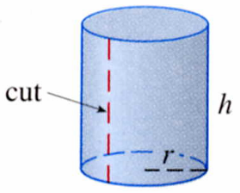
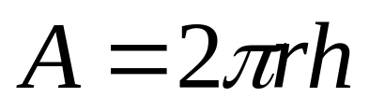
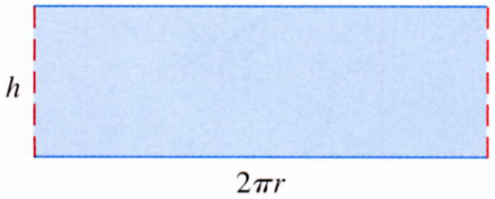

Slide 3

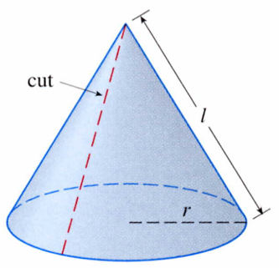
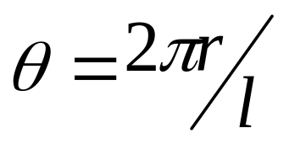
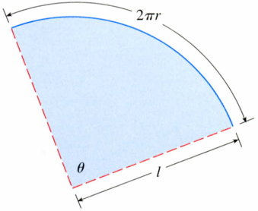
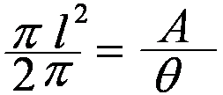
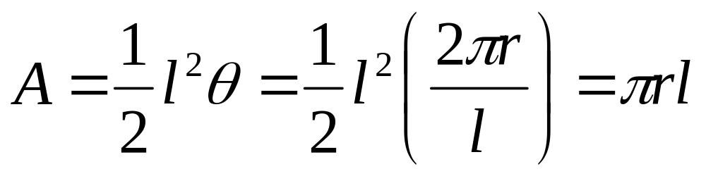
Surface Area

Slide 4
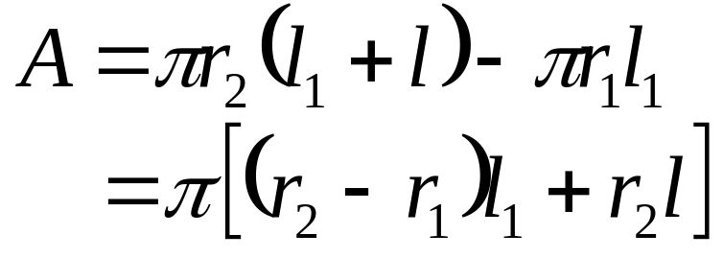
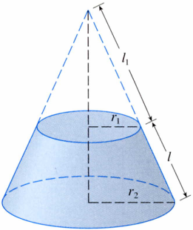
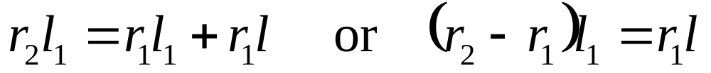
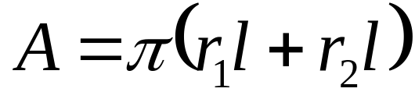
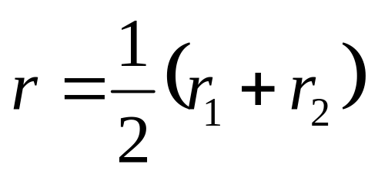
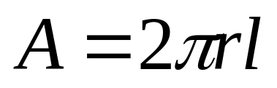
1
l
l
+
l
From similar triangles
1
=
1
r
r
1
2
A
Putting this in Equation 1.
2

Slide 5
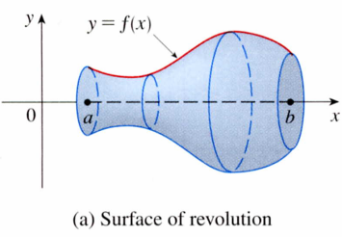
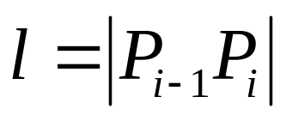
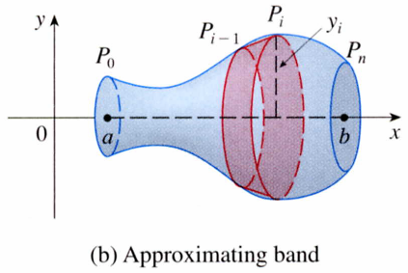

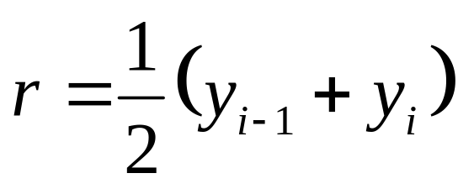
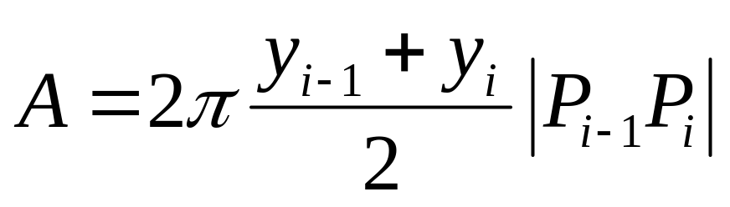
Divide the interval [a,b] into n subintervals with endpoint x₀,x₁,.....,x_{n} and equal with Δx .
y
y=f(x)
0
x
The part of the surface between x_{i－1} and x_{i} is approximated by taking the line segment P_{i－1}P_{i} and rotating it about the x-axis.
a≦X≦b
(a) Surface of revolution
P_{i}(x_{i},y_{i})
P_{i-1}(x_{i-1},y_{i-1})
y
P₀
P_{n}
0
x
(b) Approximating band

Slide 6
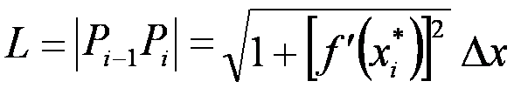
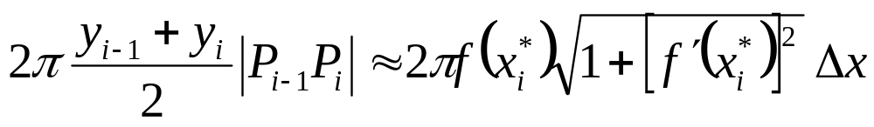
Theorem 8.1.2
When △X is small f (x) is continuous.
X_{i}* is some number in [X_{i}, X_{i-1}].
y_{i}= f(x_{i}) ≒ f (x_{i}*),
y_{i-1}= f(x_{i-1})≒ f (x_{i}*),
y_{i}= y_{i-1} ≒ f (x_{i}*)
The area of a surface of revolution:

Slide 7
The area of the complete surface of revolution is
(
)
[
(
]
n
)
∑
π
*
+
′
*
2
Δ
3
2
f
x
1
f
x
x
i
i
i
=
1
ｄｓ
ｎ→∞
ｄｙ
P_{i}(x_{i},y_{i})
P_{i-1}(x_{i-1},y_{i-1})
ｄｘ
｜P_{i-1}P_{i}｜＝ds
y
P₀
P_{n}
ｄｓ＝ ｄｘ^{２}＋ｄｙ^{２}
ｄｙ
0
＝
２
x
１＋（ ） ｄｘ
ｄｘ
ｄｘ
＝
２
１＋（ ） ｄｙ
Approximating band
ｄｙ

Slide 8
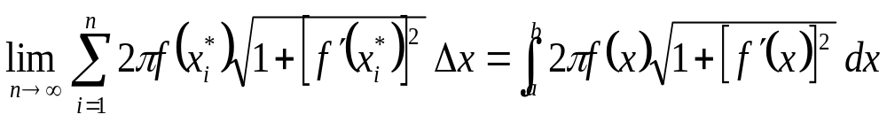
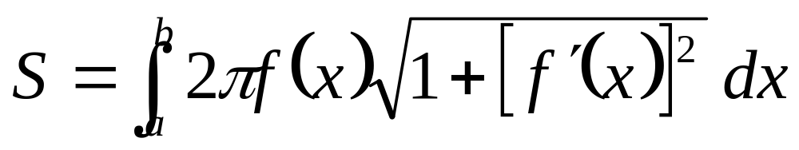
This approximation appears to become better as n→∞，
Therefore, where f is positive and has a continuous derivative.
The surface area of the surface obtained by rotating the curve.
4

Slide 9
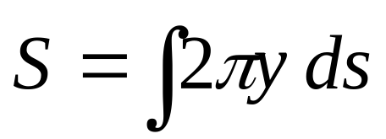
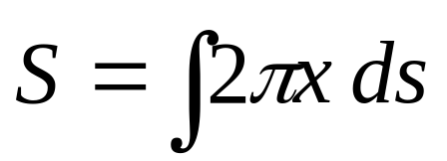
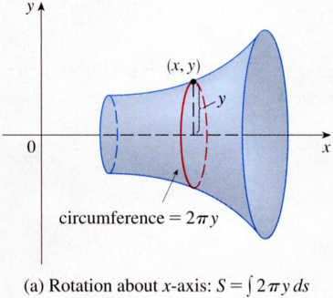
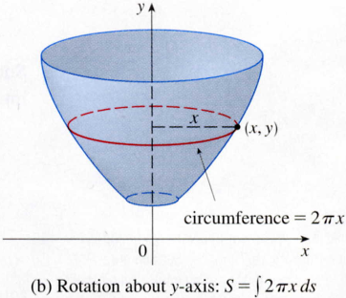

7
8
dy
dx
ds = 1 +( )² dx ,
ds = 1 +( )² dy
dx
dy
(x, y)
y
x
(x, y)
circumference2πx
circumference2πy
Rotation about the x-axis.
Rotation about the y-axis.

Slide 10
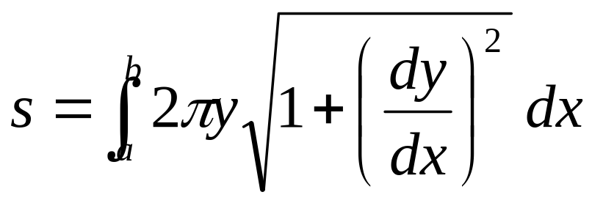
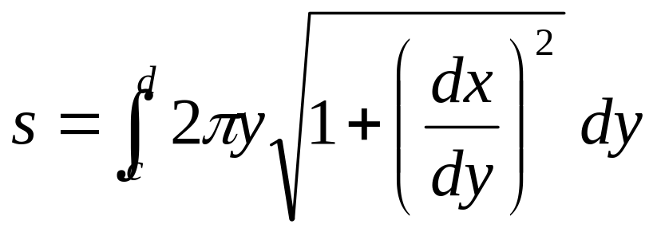
If the curve is described as y = f (x), a≦x≦b
5
(繞x軸旋轉)
If the curve is described as x = g(y), c≦y≦d
6
x
(繞y軸旋轉)
Both Formulas 5 and 6 can be summarized symbolically, using the notation for arc length given in Section 8.1, as

Slide 11
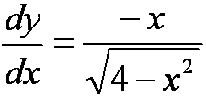
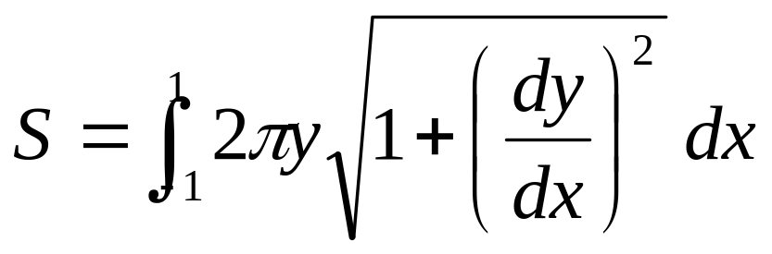
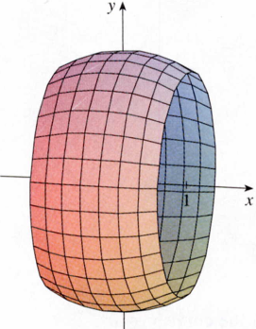
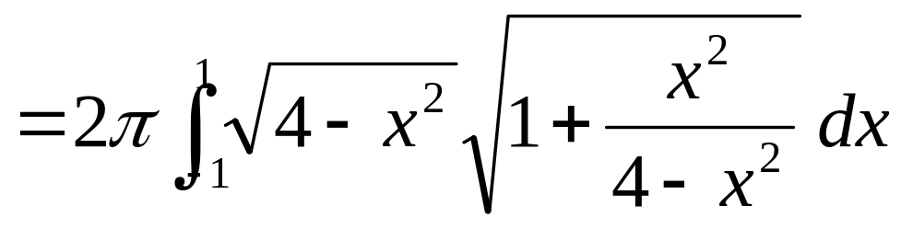
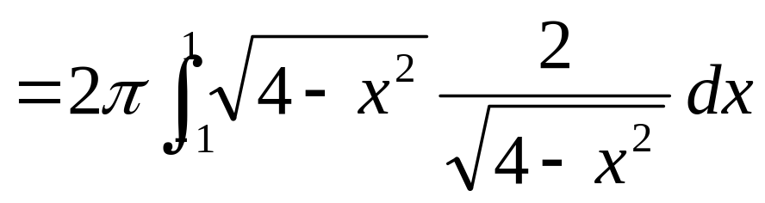
EXAMPLE 1
The curve y= 4- x² , -1≦x≦1, is an arc of the circle x²+y²= 4. Find the area of the surface obtained by rotating this arc about the x-axis. (The surface is a portion of a sphere of radius 2)
SOLUTION
y
y
x
= 8π
x= -1
x=1

Slide 12
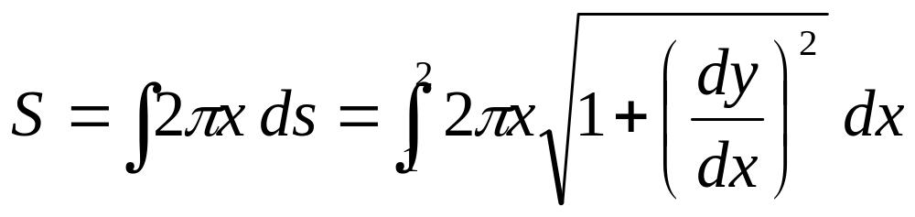
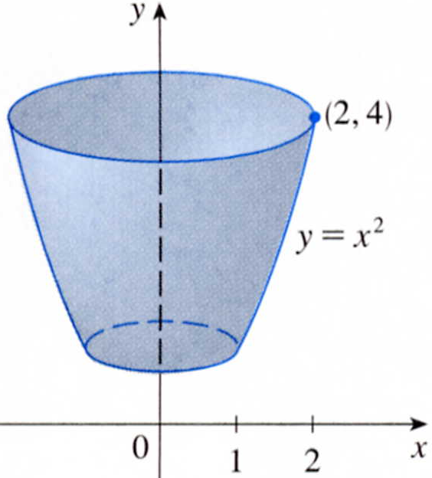
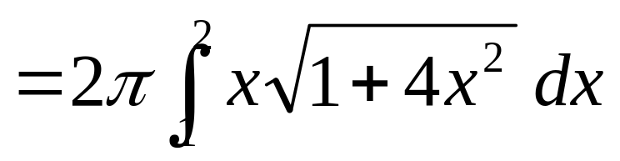



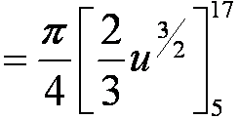
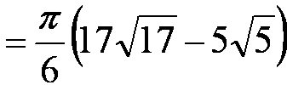
EXAMPLE 2
The arc of the parabola y= x² from(1,1) to (2, 4) is rotated about the y-axis. Find the area of the resulting surface.
SOLUTION 1
(2,4)
x
y=x²
dy/dx= 2x
(1,1)
u=1 +4x²
0
du=8x dx
x=2 u=17
X=1 u=5

Slide 13
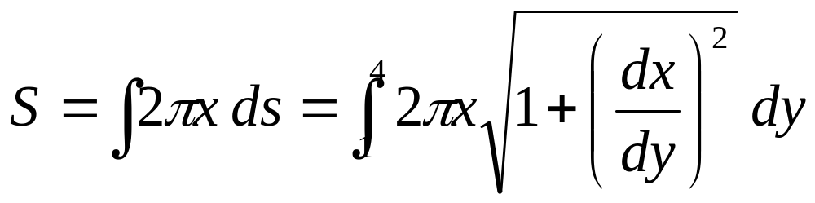
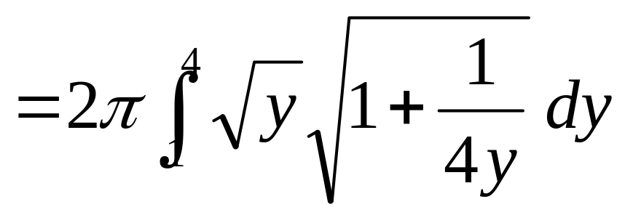
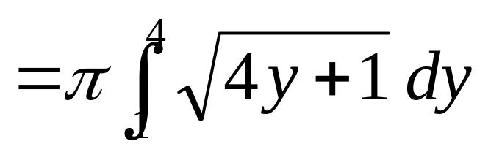
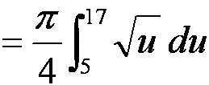
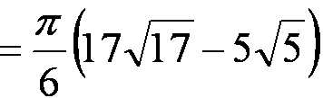
SOLUTION 2
x= y ,
(2,4)
x
dx
1
=
dy
2 y
(1,1)
u= 4y +1
0
du=4dy

Slide 14
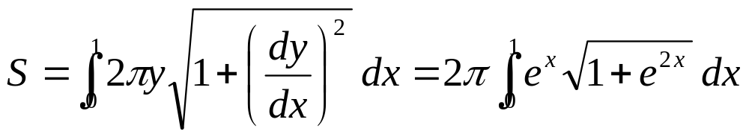
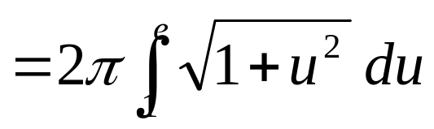

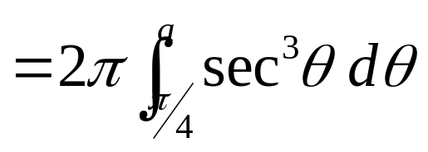
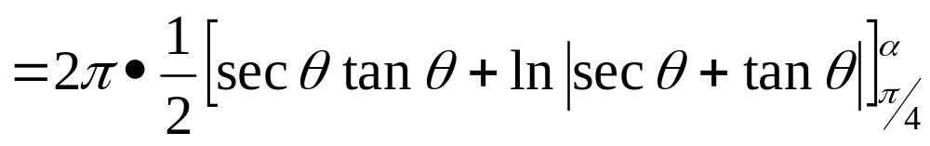
EXAMPLE 3
Find the area of the surface generated by rotating the curve y= e^{x}, 0≦X≦1, about the x-axis.
SOLUTION
ｄｙ/dx= e^{x}
α
u= e^{x},
π/4
du=e^{x} dx
（参考7-2 Ex8；部分積分）
u= tanθ
du=sec²θdθ
α= tan⁻¹e

Slide 15
8-2 Exercises
EX3 , EX11

